Slide 1

Presentation on Major-Project Session 2022-2023
Government Engineering College, Raipur
Department of computer science and engineering
Guided by:
Mrs. Hazara Anjum khan
Assistant Professor of Computer science and Engineering
Group Member :
Sandeep Painkra
Gagan deep ekka
Pushpendra Kumar

Slide 2
Project Title :- EventHub

Slide 3
Introduction
An event hub is a android App that is specifically designed to provide information about an event and facilitate event planning and management. These Aap typically include details about the event, such as the date, time, location, and agenda, as well as information on how to register,. They may also offer features such as online event planning tools, social media integration, and mobile access. Examples of event organization websites include Eventbrite, Meetup, and Cvent

Slide 4
Problem Statement
Student life is busy at your university campus with many classes, lectures and seminars happening at the same time. However, it is hard to keep up since information is too spread out throughout university departments.
Sports, athletics and performing arts events are an important part of university life. You want to keep your audience informed, drive attendance to your upcoming events, and create loyal fans
There is so much going on at the same time. It is difficult to collect, present and distribute all the relevant events that are happening in your campus.
Events are community-led. Thus, you need your community to tell you and others what is happening

Slide 5
Observation Table
S N | Title | Author | Frame work | parameters | limitations | Adaptivity
1 | Study on Event Management Applications | Akash Verma , Gunjan Srivastava, Himanshu Verma, Mayank Johri | System deign, Process mangment,freme working process | Deign process System, student data mangment | Event management process is small and all event are not organized | Management process
2 | Android Application for Event Management and Information Propagation | Phanuphong Hathaiwichian, Lapas Siriwittayacharoen Apinat Wongwachirawanich, and Chaiyong Ragkhitwetsagu | Authentication System | Member Registration System:, Log-in System, Event Management System |  | Android mangemenent
3 | Android Application for Event Management System | R Deepika, R Gayathri, T Saravanakumar , K Vigneshwaran , K Vignesh | System deign, Process mangment | Deign process system | All event are not mange | All event add
4

Slide 6
Tools
Frontend
React Native :- React Native is an open-source UI software framework created by Meta Platforms, Inc. It is used to develop applications for Android, Android TV, iOS, macOS, tv OS, Web, Windows and UWP by enabling developers to use the React framework along with native platform capabilities
back-end
Node.js:- Node.js is a cross-platform, open-source server environment that can run on Windows, Linux, Unix, macOS, and more. Node.js is a back-end JavaScript runtime environment, runs on the V8 JavaScript Engine, and executes JavaScript code outside a web browser
Data base
MongoDB is a source-available cross-platform document-oriented database program. Classified as a NoSQL database program, MongoDB uses JSON-like documents with optional schemas

Slide 7
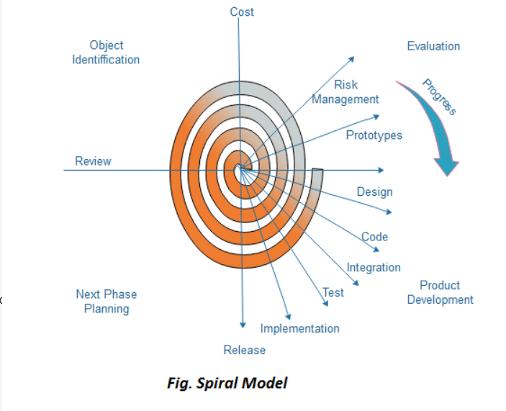
Methodology

Slide 8
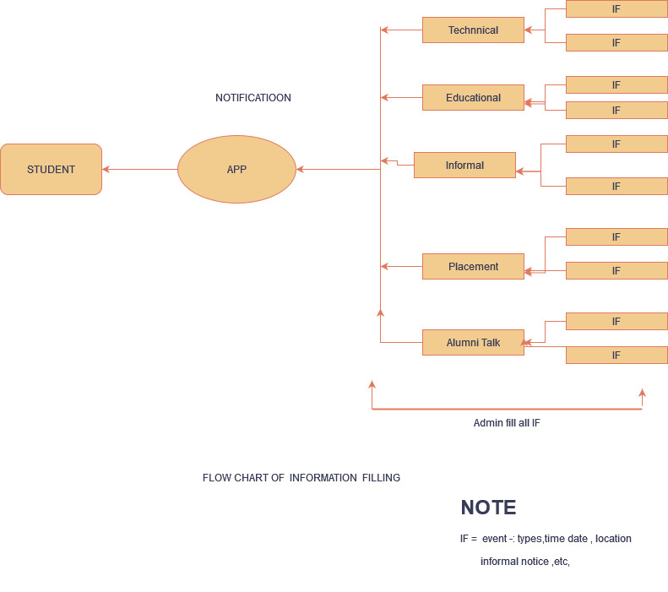
Basic work flow structure

Slide 9
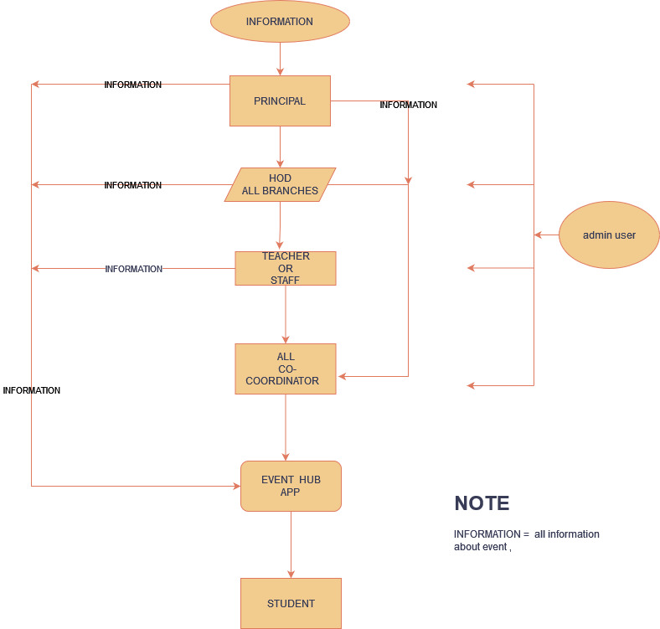
Information management system

Slide 10
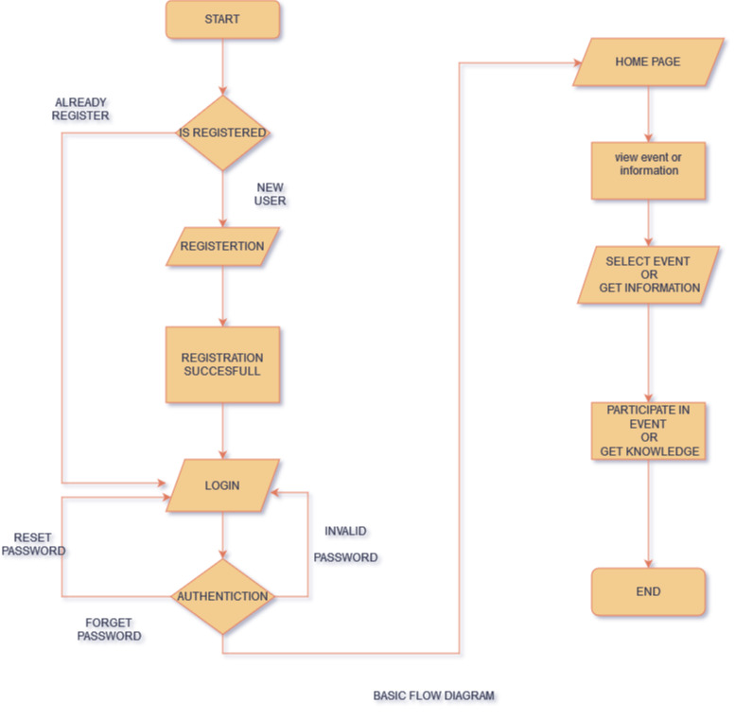
Basic work flow structure

Slide 11
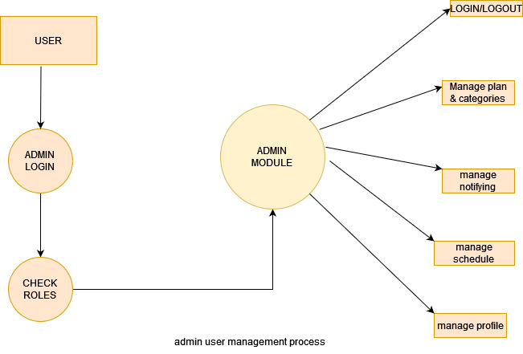

Slide 12
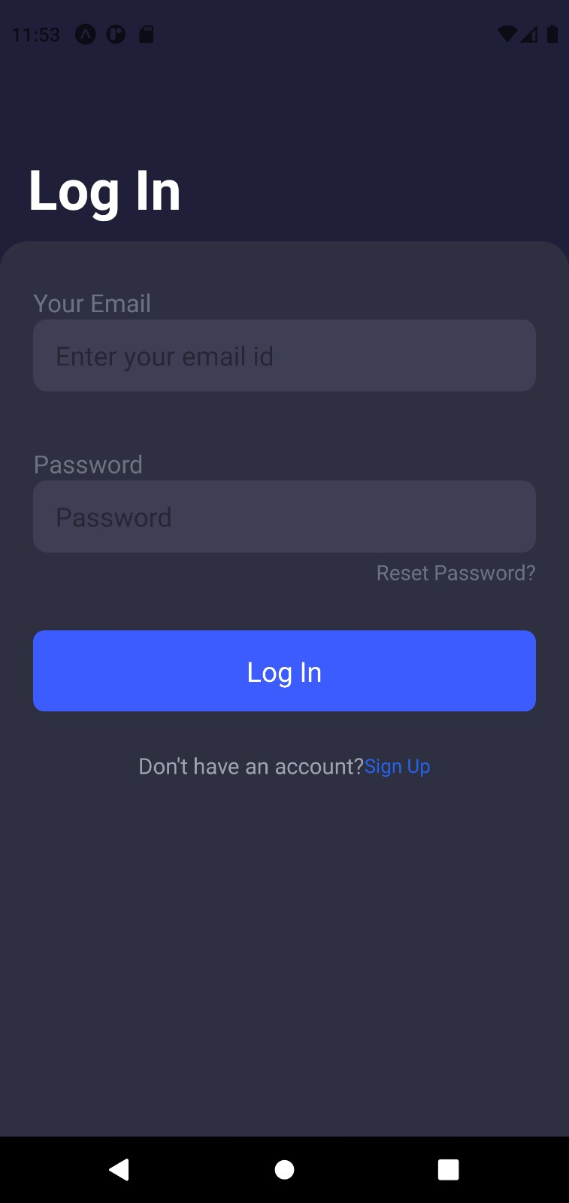
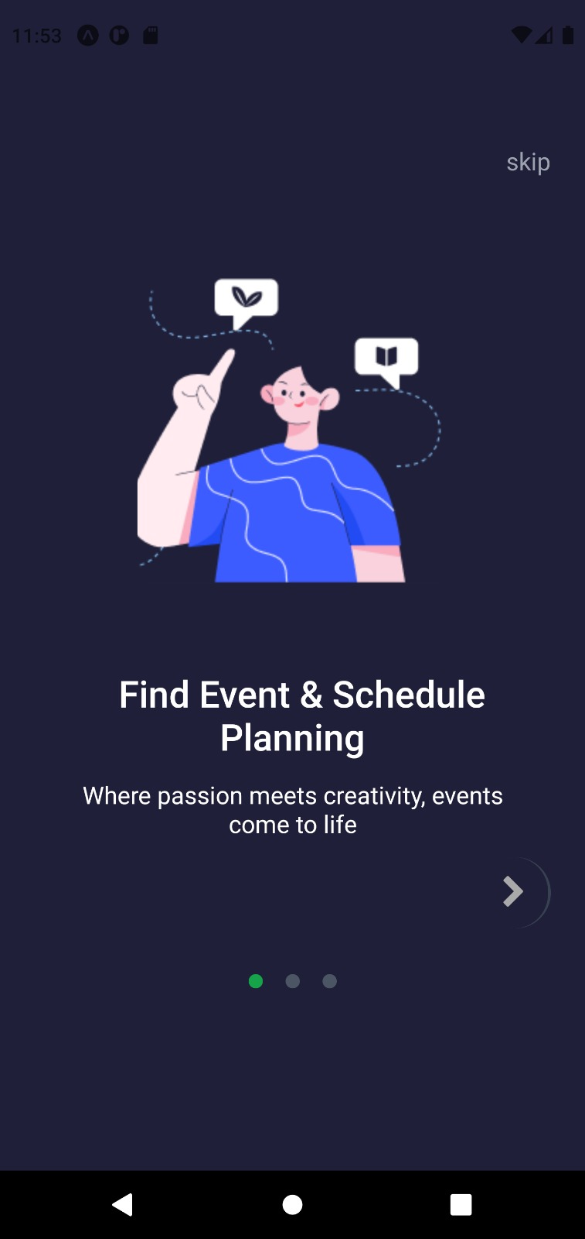
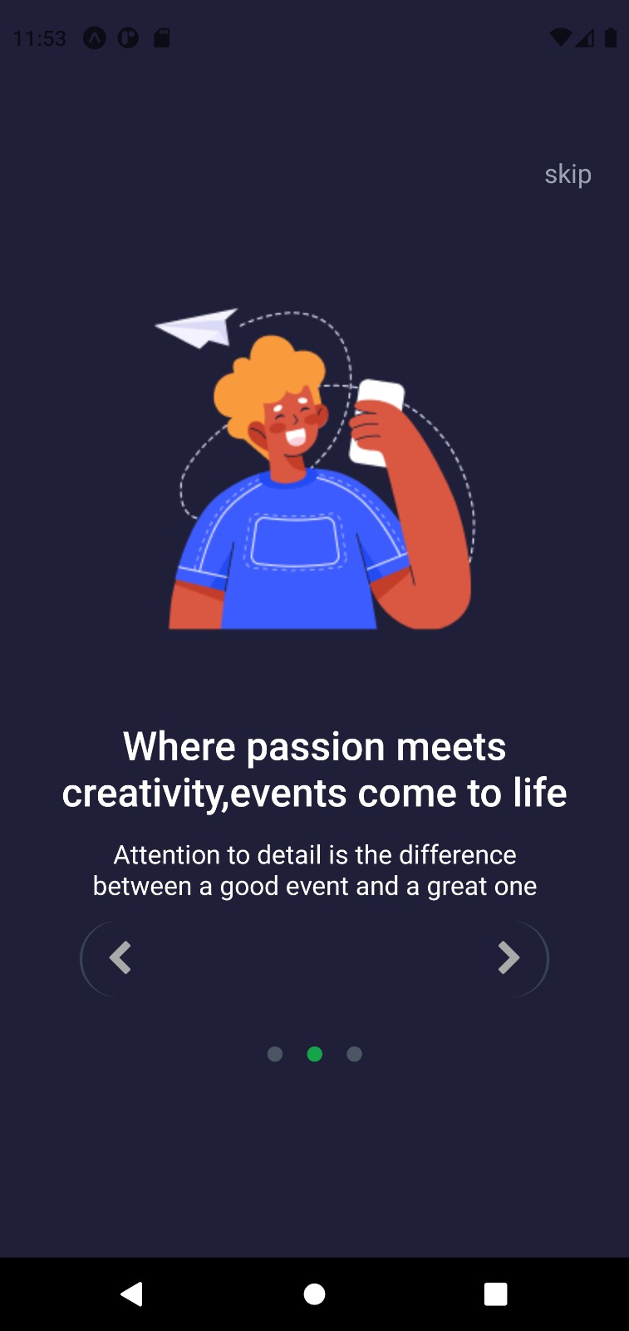
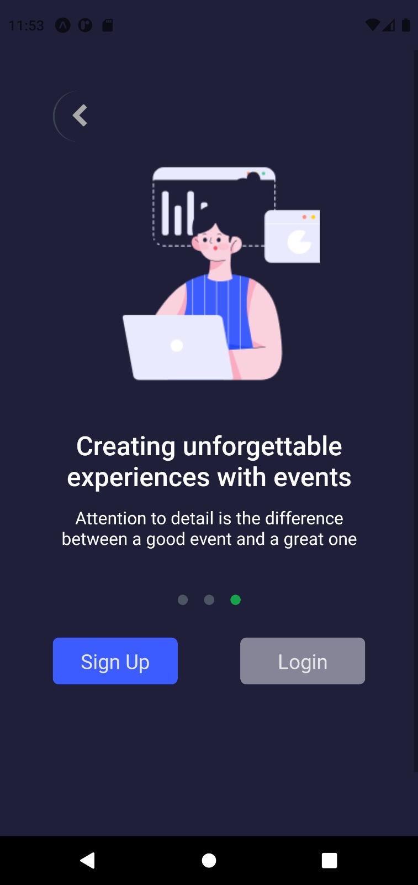
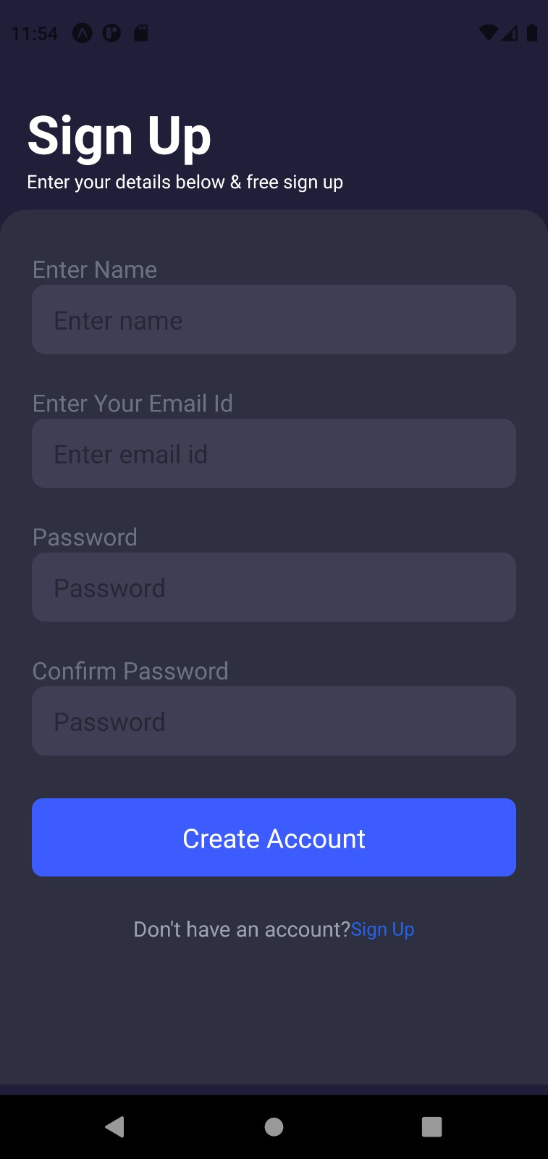
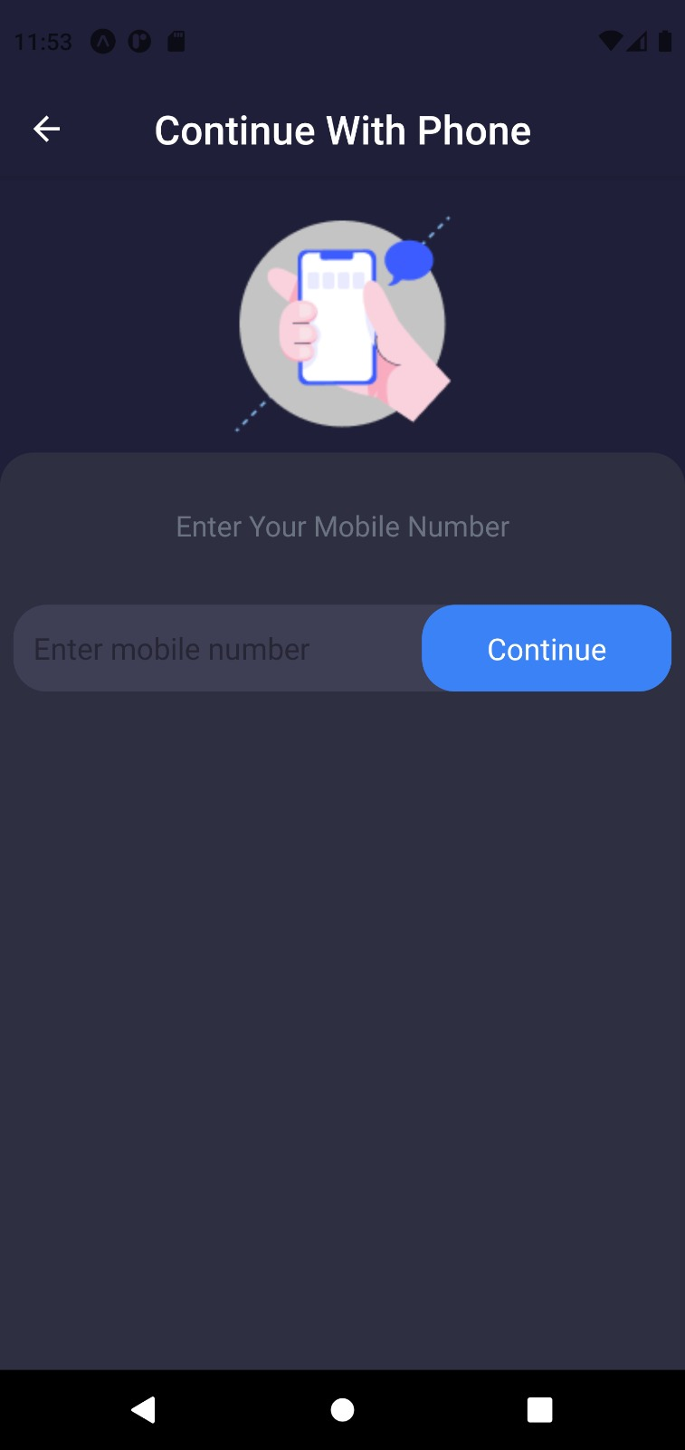
Result

Slide 13
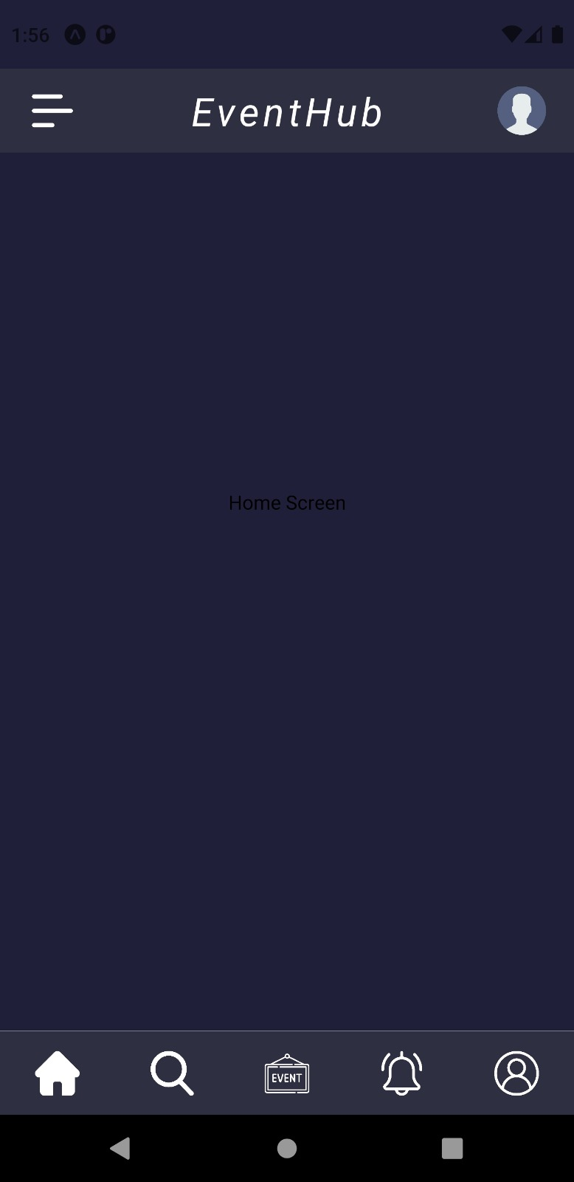
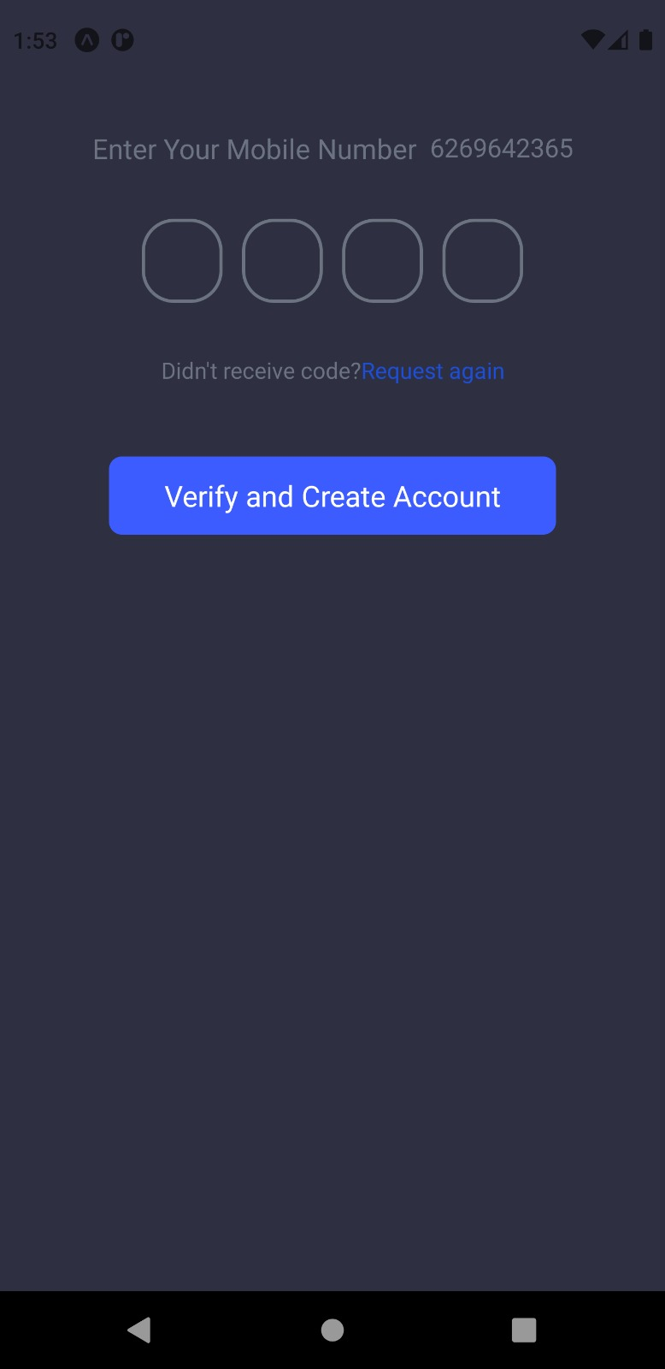
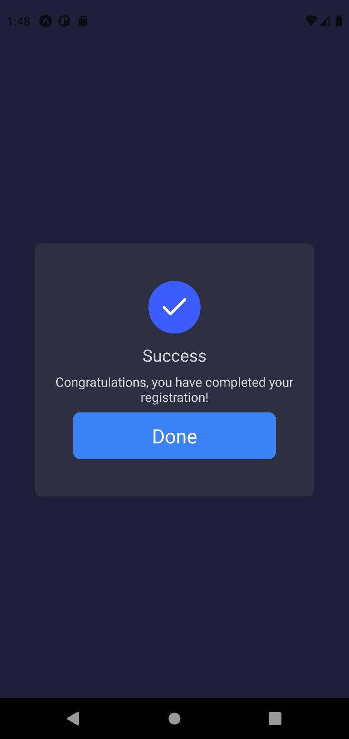
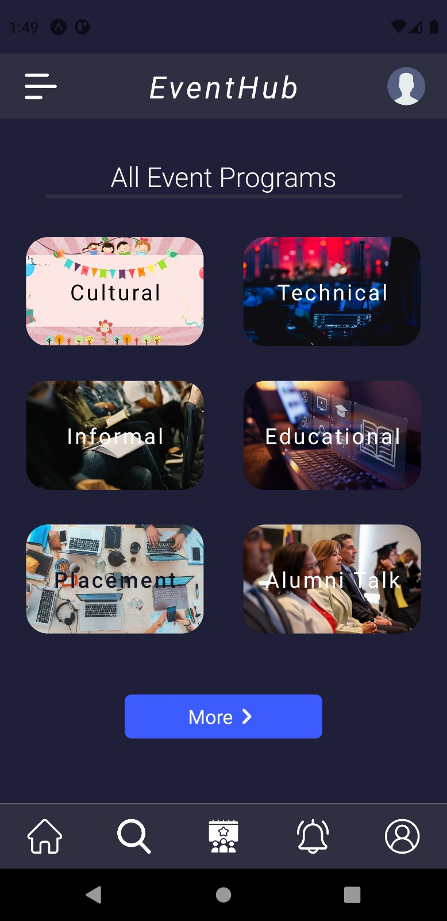

Slide 14
Reference
Lalit Mohan Joshi MTech scholar BTKIT Dwarahat, Almora, UttarakhandInternational Journal of Computer Applications (0975 – 8887) Volume 122 – No.11, July 2015
John Allen, Robert Harris, Leo K Jago and A J Veal.
Muller-Seitz, G. & Schuler, E. 2013. From event management to managing events. A process perspective on organized and unexpected field-level events. Managementforschung 23, 193-226
IIT BHILAI MERAZ https://meraz.in/
IIIT RAIPUR https://technovate.iiitnr.ac.in/

Slide 15
Thank you

